Slide 1
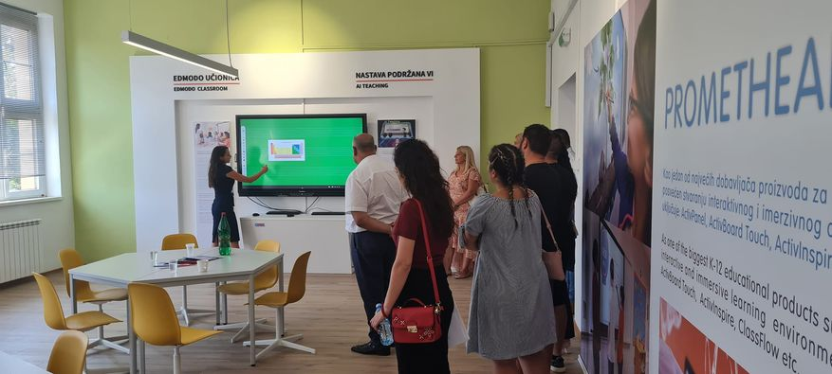
Teachers competencies for using AI in education and changing teachers and students roles

Slide 2
As AI becomes more relevant in education, it is essential for teachers to develop new competencies and skills to effectively utilize and integrate AI technologies into their teaching theory and practice. Teachers need to be motivated and trained for proficient using AI tools and technologies. This includes understanding how AI algorithms work, being familiar with AI powered platforms and applications, and knowing how to navigate and utilize AI based educational resources. AI relies on data analysis to provide personalized learning experiences and insights in accordance with their individual possibilities. Teachers should be able to interpret and analyze data generated by AI systems to gain insights into student performance, identify learning problems, and make data-informed instructional decisions. Their activities can be more easily monitored, measured and evaluated. It enable progress according to their background knowledge and abilities. There are some general conditions for ensuring full motivation of pupils specially by feedback information, which increase their self-confidence and responsibility. That could make good conditions for self-evaluation and give them more information's how they could succeed in rationalization and intensification of teaching. Teachers should understand how to effectively integrate AI technologies into their teaching practices and how to change teaching methods and the way of evaluating students work. This involves aligning AI tools with learning objectives, designing AI-based learning activities, and utilizing AI to support different instructional strategies in using modern educational technology. As new technologies evolve, teachers need to be adaptable and willing to continuously learn and update their skills. This includes staying informed about the latest technology in education, participating in professional development opportunities, and collaborating with other educators to share best practices.Teachers, also, must be aware of the ethical implications of using AI in education and some problems with the applications that are not completely made according to ethical principles. They should understand issues related to data privacy, security, and algorithmic bias. Teachers should ensure that AI tools are used responsibly, ethically, and in a manner that respects student privacy and promotes equity

Slide 3
Teachers should be able to facilitate collaborative learning experiences using AI-based platforms and tools. They should also be comfortable collaborating with AI systems, such as virtual assistants and chatbots, to support student learning and provide personalized feedback. While AI can automate certain tasks, teachers play a main role in developing critical thinking skills and encourage students creativity. Teachers should design learning experiences that encourage students to think critically about AI-generated content, question assumptions, and develop creative problem-solving skills. Teachers could not be replaced because AI technologies may lack the emotional connection and empathy that human teachers provide which is very important for their development. Teachers should focus on building strong relationships with students, providing emotional support, collaboration and creating a supportive and inclusive classroom environment. By developing these competencies, teachers can effectively leverage AI technologies to enhance their teaching practices, personalize learning experiences, and support student success. It is important for educators to embrace AI as a tool that complements their expertise and enhances their ability to meet the diverse needs of students in the digital age.

Slide 4
Improving teacher role in education with AI
Some educational experts have claimed that AI supported teaching, by giving students possibility for self education and self-evaluation, will push out teachers. It could make them unnecessary in a certain way which will provoke revolution in teaching putting students in the position of independent learning creator. Researches concluded that supervised teaching, powered by smart devises based on AI with new methods, changes role of teachers, but can not replace them. According to new rules, when AI supported teaching is well prepared, teachers became mostly organizers, planners, somebody who directs, researchers, verifications of pupil's work and educators. They aren't only information storage, walking and speaking textbook and living encyclopedia. While both learning and teaching are crucial components of the education process, the ultimate goals are to facilitate better learning outcomes for students and their motivation to learn. AI can analyze individual student data and provide personalized recommendations, content, and activities tailored to their specific needs and learning styles. This personalized approach helps students engage more deeply with the material and optimize their learning outcomes. AI-based assessments can adapt to students' responses, providing questions and tasks that are appropriately challenging. This ensures that students are appropriately challenged and receive feedback that is targeted to their individual learning needs and their background knowledge. Software based on AI can provide immediate feedback to students on their performance, allowing them to identify and correct mistakes in real-time .

Slide 5
This timely feedback helps students understand their strengths and weaknesses, allowing them to make changes and improve their learning. AI can help students access a wide range of educational resources and information. AI-based platforms can recommend relevant content, suggest additional readings, and provide access to online libraries, enhancing students' ability to explore and deepen their understanding of topics. New technologies, such as virtual reality (VR), augmented reality (AR), and gamification, can create immersive and interactive learning experiences. Teachers become convinced that AI-based teaching and learning, used in combination with the other kinds of teaching, present an attractive and useful innovation. On the other hand, for composing, verification and implementation of program a lot of teachers effort is necessary, as well as material investments and pedagogically qualified personnel, which make it more difficult than traditional education. For that reason many programes, which are criticized now, are not composed enough professionally and they are not tested in practice by authorized experts. Sometimes it could make the situation in which teachers would refuse innovation if they think that it is not enough pedagogically moderated and designed. AI-based teaching and learning is still relatively new concept and it is still insufficiently elaborated and therefore many critical remarks and some results should be taken conditionally. All weaknesses of this teaching, that we have been talking about so far, will not be shown in practice if it is programmed and organized professionally

Slide 6
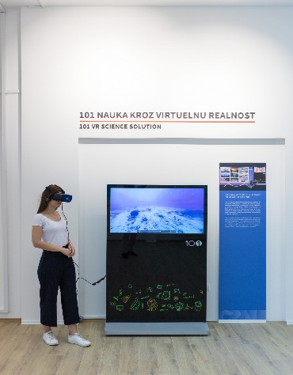
AI-based teaching and learning results satisfies logic of learning, opens new learning possibilities, stimulates pupil's activity, provides advancement at their own speed, makes teaching more attractive, provides economy and efficiency of teaching and therewith belongs to such kind of teaching which is most suitable to needs and interests of young people. The most important is that this new teaching and learning organization increase internal and external student motivation and help them to got functional knowledge, understand facts and procedures. It also helps students to have more permanent knowledge. These technologies engage students, promote active learning, and make the learning process more enjoyable and memorable. AI can adapt to different learning styles and preferences, accommodating diverse learners. For example, some students may prefer visual learning, while others may prefer auditory or kinesthetic approaches. AI can provide content and activities that cater to individual learning preferences. Modern technologies can improve accessibility for students with disabilities. AI-based speech recognition and text-to-speech tools can assist students with visual impairments or learning disabilities, enabling them to access educational materials more effectively. AI can analyze large amounts of data on student performance and learning patterns, providing valuable insights to educators. These insights can help teachers understand the effectiveness of their instructional strategies, identify areas of improvement, and tailor their teaching approaches to better meet student individual needs.

Slide 7
Changing students role in modern education
As education evolves with the integration of AI, students' roles are also changing. Essential change is that students will not be passive actors in formal education, but they should become active learners and researchers. They have access to personalized learning experiences, interactive resources, and adaptive assessments. Students are encouraged to take ownership of their learning journey, set goals, and make choices that align with their interests and backround knowledge and abilities. AI technologies provide students with the tools and resources to engage in self-directed learning. Students can explore topics of interest, access educational materials at their own pace, and take responsibility for their learning progress. AI-based platforms can offer recommendations and guidance, empowering students to drive their own learning experiences. . It ensures consistency in the pace of learning and detail of the presented content, maximum adaptability to the individual abilities of pupils, their psychological characteristics, speed and style of learning. The material is logically given in sequences in which the acquisition of subsequent knowledge is logically connected with the previously learned, including constant connection of pupils with teachers .

Slide 8
AI encourages students to develop critical thinking and problem-solving skills. Rather than passively consuming information, students are challenged to analyze, evaluate, and synthesize knowledge. AI technologies can provide students with opportunities to engage in complex problem-solving tasks and develop their analytical and creative thinking abilities. AI facilitates collaborative learning experiences, enabling students to work together on projects, share ideas, and engage in discussions. Students learn to collaborate effectively, communicate their thoughts, and respect diverse perspectives. AI-based tools can support virtual collaboration, allowing students to connect and collaborate beyond the confines of the physical classroom. With the integration of AI, students need to develop digital literacy skills. They must be proficient in using AI tools, navigating digital platforms, and critically evaluating online resources. Students learn to navigate digital environments responsibly, understand the ethical implications of AI, and become informed digital citizens. New technologies promotes a culture of lifelong learning. Students understand that learning is not limited to the classroom and that they need to continuously update their skills and adapt to a rapidly changing world. AI technologies can provide personalized recommendations for further learning, helping students develop a growth mindset and a desire for continuous improvement. Educational technologies can support students in expressing their creativity. Students can use AI-based tools for digital art, music composition, storytelling, and other creative endeavors. AI can provide students with new avenues to explore and express their unique talents and perspectives.

Slide 9

With AI, students have the opportunity to voice their opinions and advocate for causes they believe in. They can use AI technologies to research, gather data, and present their ideas effectively. Students become empowered advocates for social and environmental issues, leveraging AI to drive positive change in their communities. As education embraces AI, students' roles are shifting from passive recipients of knowledge to active participants in their own learning. They develop essential skills, become lifelong learners, and contribute to a more collaborative and innovative educational landscape. By leveraging AI to enhance the learning process, educators can create more engaging, personalized, and effective learning experiences for students. While teaching remains an essential component, the focus shifts towards facilitating and supporting better learning outcomes for students and developing empathy and social competences.

