Slide 1
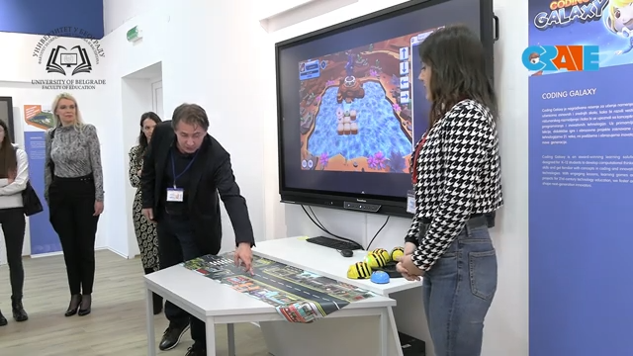
Robots and Bee-Bots in education

Slide 2
Robots and Bee-Bots are two examples of educational tools that can be used to enhance learning experiences in the classroom. Robots and Bee-Bots provide students with hands-on learning experiences. They allow students to physically interact with the technology, program it, and observe the outcomes. This hands-on approach promotes active engagement and deeper understanding of concepts. Programming robots like Bee-Bots requires students to think logically and sequentially. They learn to break down problems into smaller steps, develop algorithms, and test their solutions. This cultivates computational thinking skills, which are valuable in problem-solving and critical reasoning .Using robots in group activities encourages collaboration and communication among students. They need to work together to program the robot, plan strategies, and solve challenges. This promotes teamwork, effective communication, and the ability to express ideas clearly.
Robots and Bee-Bots can be used to introduce students to STEM (Science, Technology, Engineering, and Mathematics) concepts. Students can explore coding, robotics, and engineering principles through hands-on activities. This helps develop their interest in STEM fields and prepares them for future careers in these areas. Robots provide opportunities for students to be creative, innovative and new technology friendly oriented. They can design and program their own unique tasks or challenges for the robots. This fosters creativity, problem-solving, and thinking outside the box. Robots can be integrated into various subject areas, including math, science, language arts, and social studies. For example, students can use robots to explore geometry by programming them to move in specific patterns or to simulate historical events in social studies. This multidisciplinary approach helps students see the connections between different subjects. Robots and Bee-Bots can be beneficial for students with diverse learning needs.

Slide 3
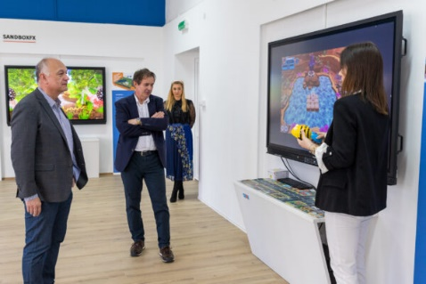
They provide a non-judgmental and accessible platform for learning. Students with disabilities or learning differences can actively participate, engage, and succeed in programming and controlling the robots. They can make learning more engaging and enjoyable for students. The novelty and interactive nature of these tools capture students' attention and motivate them to explore and learn. This can help increase student participation and interest in the subject matter. Robots and Bee-Bots are valuable tools that can enhance learning experiences by promoting hands-on, collaborative, and creative learning. They support the development of various skills, including computational thinking, problem-solving, teamwork, and creativity. Integrating these technologies into the classroom can create a dynamic and engaging learning environment.

Slide 4
The use of AI and robots in education offers several benefits that enhance the learning experience for students. AI can analyze individual student data and provide personalized recommendations and resources tailored to each student's needs and learning style. This personalized approach helps students learn at their own pace, address their specific learning gaps, and maximize their learning potential. Robots and AI technologies can make learning more interactive and engaging. They provide hands-on experiences, simulations, and gamification elements that capture students' attention and motivate them to actively participate in the learning process. AI-powered platforms and robots can provide immediate and specific feedback to students. This feedback helps students understand their strengths and weaknesses, identify areas for improvement, and make adjustments in real-time. It promotes self-reflection and enables students to take ownership of their learning. AI technologies can adapt to different learning styles and preferences, accommodating diverse learners. Visual, auditory, and kinesthetic learners can all benefit from AI-powered tools that provide content and activities tailored to their individual needs. AI can provide students with access to a vast array of educational resources and information. AI-powered platforms can recommend relevant content, suggest additional readings, and offer personalized learning pathways. This expands students' access to knowledge and promotes independent exploration. Robots and AI technologies can facilitate collaborative learning experiences. Students can work together in teams, program robots, and solve problems collectively. This promotes teamwork, communication skills, and the ability to collaborate effectively.AI and robotics offer opportunities for students to engage with real-world applications of technology. They can learn about coding, robotics, and AI principles that are increasingly relevant in today's society.

Slide 5
This prepares them for future careers and equips them with valuable skills for the digital age. AI and robots can support inclusive education by providing accessible learning experiences for students with disabilities or learning differences. These technologies can be adapted to meet individual needs, ensuring that all students have equal opportunities to engage and succeed in the classroom. Overall, the use of AI and robots in education enhances personalized learning, engagement, feedback, and collaboration. It expands access to resources and promotes inclusive education. By integrating these technologies into the classroom, educators can create dynamic and effective learning environments that prepare students for the challenges of the future. Traditional forms, methods and educational organization should be changed in accordance with student’s needs. Students are using smart devices from early childhood and it is almost impossible to forbid new technologies in their learning process. On the contrary, we are aware that they will increase internal and external student’s motivation by using AI in education. New way of teaching means reducing time for teacher’s speeches and students activations in self educating by exploring and researching didactical resources and making progress according to their background knowledge and their abilities. Artificial intelligence could help us to make individualization and differentiation personalized for each student. In addition, it could help us to measure progress according to several tasks and quizzes that could be a part of new sort of textbooks.

Slide 6
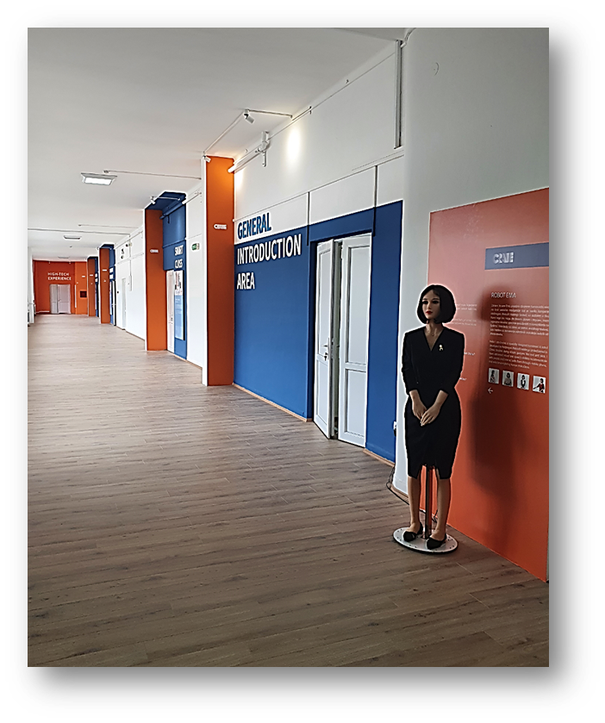
Concept of textbooks should also be rearranged in order to give all necessary information for students, but not to overload human memory. New concept could have reduced essential information for each subject with a lot of QR codes or hyperlinks which leads to didactical resources on internet. It means that we should replace this liner textbook concept with branched one, which will allow students to reach resources according to their own interests, needs and background knowledge. Books should be interactive with a lot of tasks and quizzes where students could receive feedback information about their progress in learning. In addition, this concept might be powered by artificial intelligence so teachers and students could evaluate each step that student make to complete a project or solve a problem . It means that we are changing educational paradigm with new methodology and new way of complex evaluating students work. AI is very useful in providing assistance for software engineers to make programs, or to test software. It could also help beginners in programing to understand procedures and logic in coding and in developing algorithmic way of thinking.

