Slide 1
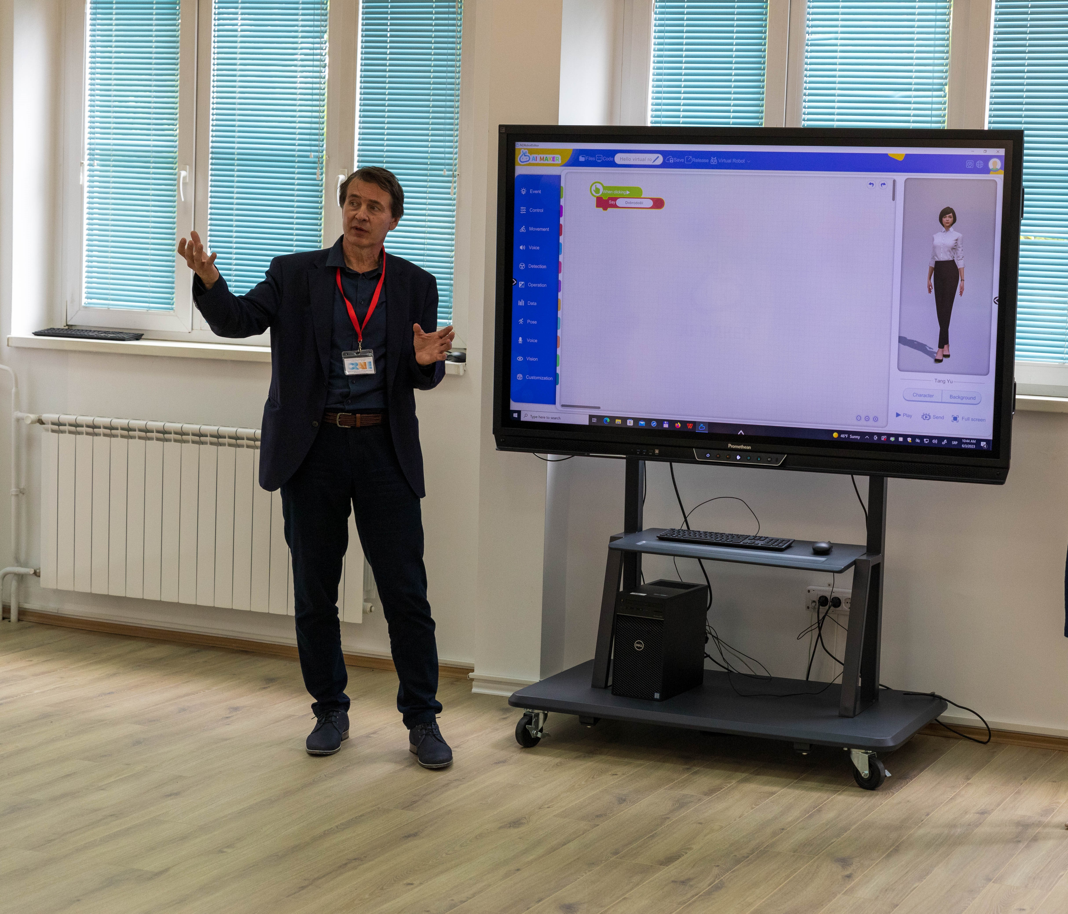
Smart learning in practice

Slide 2
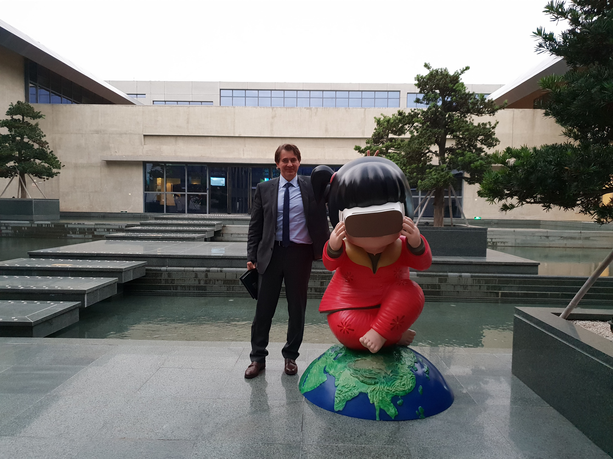
Smart learning devices and their role in everyday life are themes that we included in curricula for the subject “Digital world” in the first four years in primary school. Our idea was to inform them how technology is changing way of life and how to properly use digital devices. Student are aware of advantages made by using modern digital devices, but also we tried to explain them how to keep safety even with exchanging a lot of information about themselves. We are trying to teach young pupils how to think in algorithmic way and how to program some basic smart devices. Smart learning devices enables developing of motivation of pupils when we use them properly, they could support concentration of attention in a learning process, they could cause adequate responses of pupils in teaching process which are very important for learning quality. Using ICT in learning and teaching, as well as in evaluating students achievement require special organization of teaching and learning work supported by new methods and new educational technology. It could help students to rise level of understanding teaching contents, their more precise acceptance and more correct repetition, but maybe most important is to connect theory with real life problems and practice. Teaching devices, if teachers and students use them in a correct way, can raise scientific quantity during learning process and speed up complete teaching process.

Slide 3
Smart learning devices make possibilities for pupils to understand essential thoughts of teacher in teaching process, and teacher to translate ideas he wants to present into verbs and visual language, comprehensible and understandable for pupils. It is very important if we want to rise functional knowledge and to reduce reproductive knowledge. They stimulate internal and external motivation; keep listeners awake and sensible for what is going on and what they need to do to understand content better or to solve tasks or problems that teachers gave them. Smart devices with multimedia attract attention of the youth, make closer to them contents that are difficult to comprehend, make easier their memorizing and application of gained knowledge in further learning as well as in everyday activity. It could rise quantity and quality of knowledge and help students to be able to develop critical thinking and curiosity. In Serbia we made changes in publishing law few years ago so each textbook must have electronic textbook supplement. Main idea is to enable individualization, differentiation and interactivity. Each student could reach materials according to his background knowledge, abilities and interesting. In our multimedia book for learning about wild animals there are texts based on hypertext, sounds, video clips, and pupils could have tests for self-evaluation with feedback, so teachers could give final evaluation according to all results saved in database and other activities that pupil did in order to solve a problem or learn new articles. It is very important if we want to rise internal and external pupils motivation.

Slide 4
Various tests could be done on each class so teachers and pupils could have better picture about their knowledge and they are encouraged to learn more.
Smart learning devices are rising intellectual students activity during the learning process, developing of interests for individual work after classes and they could take various tests for self-evaluation. There were some researchers at the beginning of 21st century who are explaining role of teaching aids which could almost replace teachers in a future. Thus, for example, they are having in mind Internet technologies, artificial intelligence, neural networks, robots and other new technologies in teaching biology. When they assert that, they point out to perfect teaching machines based on artificial intelligence. Most of the pedagogical experts in smart learning devices are looking new facilities for teacher work and possibility that can more completely do his function of intellectual leader, programmer, educational manager and educator of youth, to extend and enrich his function, not as potential rivals in his profession. That’s why we could say that modern smart educational devices are very well included in all educational levels, from preschool education, primary and secondary school to university level. Even old and traditional teaching aids are compatible with modern and they are bringing benefit for teachers and students. Also, we should be aware of limitation in using smart learning devices because they are not almighty, they can not „give“ knowledge without effort, the can not replace teacher, or solve all the problems brought by technological revolution, information era and „explosion of knowledge“.

Slide 5
However, they could help pupils and students to get information and new knowledge faster and easier. Interactivity with all modern educational devices helps them to make communications needed for their more complete development (affective, cognitive and psychomotor). Also it helps them to make wiser decisions, to use more successfully natural and social processes for their needs. It helps them to develop more securely, to include more creatively in the courses of social life and gain wisdom of living in sudden changes society.
Thanks to teaching aids, teacher can adjust more successfully teaching to pupils previous knowledge, interests, cognitive styles and learning styles, capabilities and work speed; he can successfully realize teaching contents on individual bases and provide active participation of pupils in all the teaching and learning phases; he can provide simultaneously information, tasks related to given information, look for and register solutions given by pupils, give additional information in case they did not solve problems successfully and provide feedback information and support to pupils.
It is well known that by activating greater number of pupils’ senses, in teaching and learning process, better possibilities for learning are made, conditions for more durable remembering of what had been learnt, more secure recognition and use of what had been remembered. Researches have shown that pupils only by reading memorize about 10.15% of teaching material, „by listening about 20%, by observing about 30-35%, by observing and listening simultaneously about 50% and by listening, observing and working about 90%. There is no doubt that teaching aids are very important for activating, in the teaching and learning process, greater number of senses; for encouraging pupils to learn while working, to make transfer of knowledge and use efficiently the acquired knowledge.

Slide 6
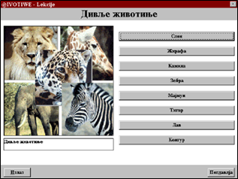
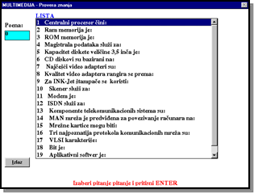
Besides, engagement of greater number of senses more corresponds to the essence of human being and the way he comes in contact with reality which is surrounding him; more corresponds to dynamic nature of child and the ways he wants to learn; more corresponds to learning manners which child had and still has in out of school and out of teaching activities.
New concept of educational technology based on supervised learning and artificial intelligence means that we should replace traditional textbooks with a new, which will have student profile with database of their achievements. Each task, quiz, paper that student finish could be evaluated so teacher will have whole picture of their work. Individualization and differentiation according to students abilities could be achieved by hyperlinks and branched textbooks instead of linear textbooks.

